Slide 1
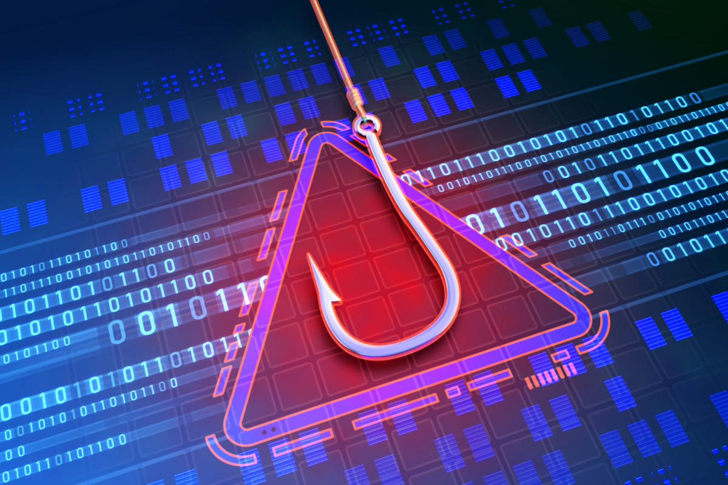
PHISHING AWARENESS

Slide 2
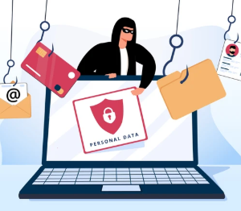
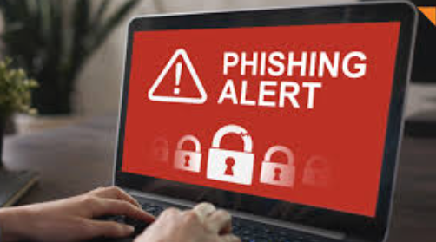
A phishing attack is a cybercrime that tricks people into giving away sensitive information. This can include passwords, credit card numbers, and other personal details

Slide 3
Common Types of Phishing Attacks
🔹 Email Phishing – Fake emails pretending to be from a trusted company, asking for login details. 🔹 Spear Phishing – Targeted attacks on specific individuals or companies with personalized messages. 🔹 Smishing (SMS Phishing) – Fraudulent messages with malicious links sent via SMS. 🔹 Vishing (Voice Phishing) – Phone calls pretending to be from a bank, police, or customer support to extract information. 🔹 Clone Phishing – A legitimate email is copied and altered with malicious links.

Slide 4
How to Avoid Phishing Attacks?
Don’t Click Suspicious Links – Always verify links before clicking, especially from unknown sources
Check URLs Carefully – Look for HTTPS and watch out for spelling mistakes (e.g., g00gle.com instead of google.com). Use Two-Factor Authentication (2FA) – Adds an extra security layer with OTPs or authentication apps. Use Strong Passwords & a Password Manager – Avoid using the same password for multiple accounts. Ignore Unverified Emails & Calls – If something feels off, verify directly with the official company.

Slide 5
What to Do If You Get Phished?
🔸 Change your passwords immediately if you entered your credentials on a suspicious site. 🔸 Inform your bank if you shared financial details. 🔸 Report the phishing attempt to cybersecurity authorities or your company’s IT team.

